Slide 1
Relationship Between
Oxygenation Changes after
RBC Transfusion and ICU Mortality
SpO2ial foRCes aka Team 4
Apoorvi Mittal, Ahram Han, Tim McMahon, Somin Sang

Slide 2
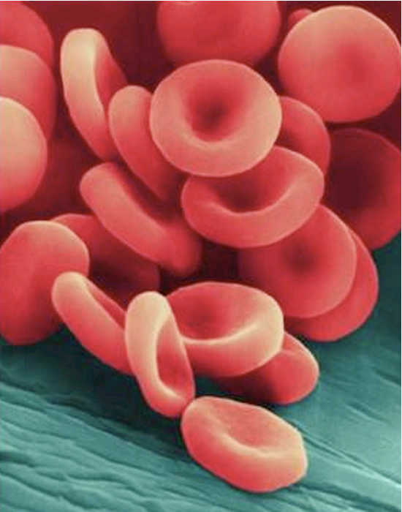
Disclosures
No financial or other conflicts of interest
We used ChatGPT, Claude
to write our code.

Slide 3



Are we benefiting anemic ICU patients by transfusing??
Our project addresses questions around the impact and mechanism of responses to RBC transfusion.
20~30% of ICU patients have moderate ~ severe anemia
RBC transfusion in ICU aims to improve oxygen-carrying capacity
(and SHOULD NOT not worsen SpO2!)
The physiological effects of RBC transfusion in ICU patients are variable, and the benefit of the transfusion is hard to assess.
Choosing Wisely®
Don't transfuse RBCs in hemodynamically stable, non-bleeding critically ill patients with Hb > 7 mg/dL
Notes:
As outlined by Dr Chris, who was one of the speakers at the symposium on Friday, we wanted to start with the what the problem is and what impact we this having on the clinical workflow. So keeping that in mind ….

Slide 4
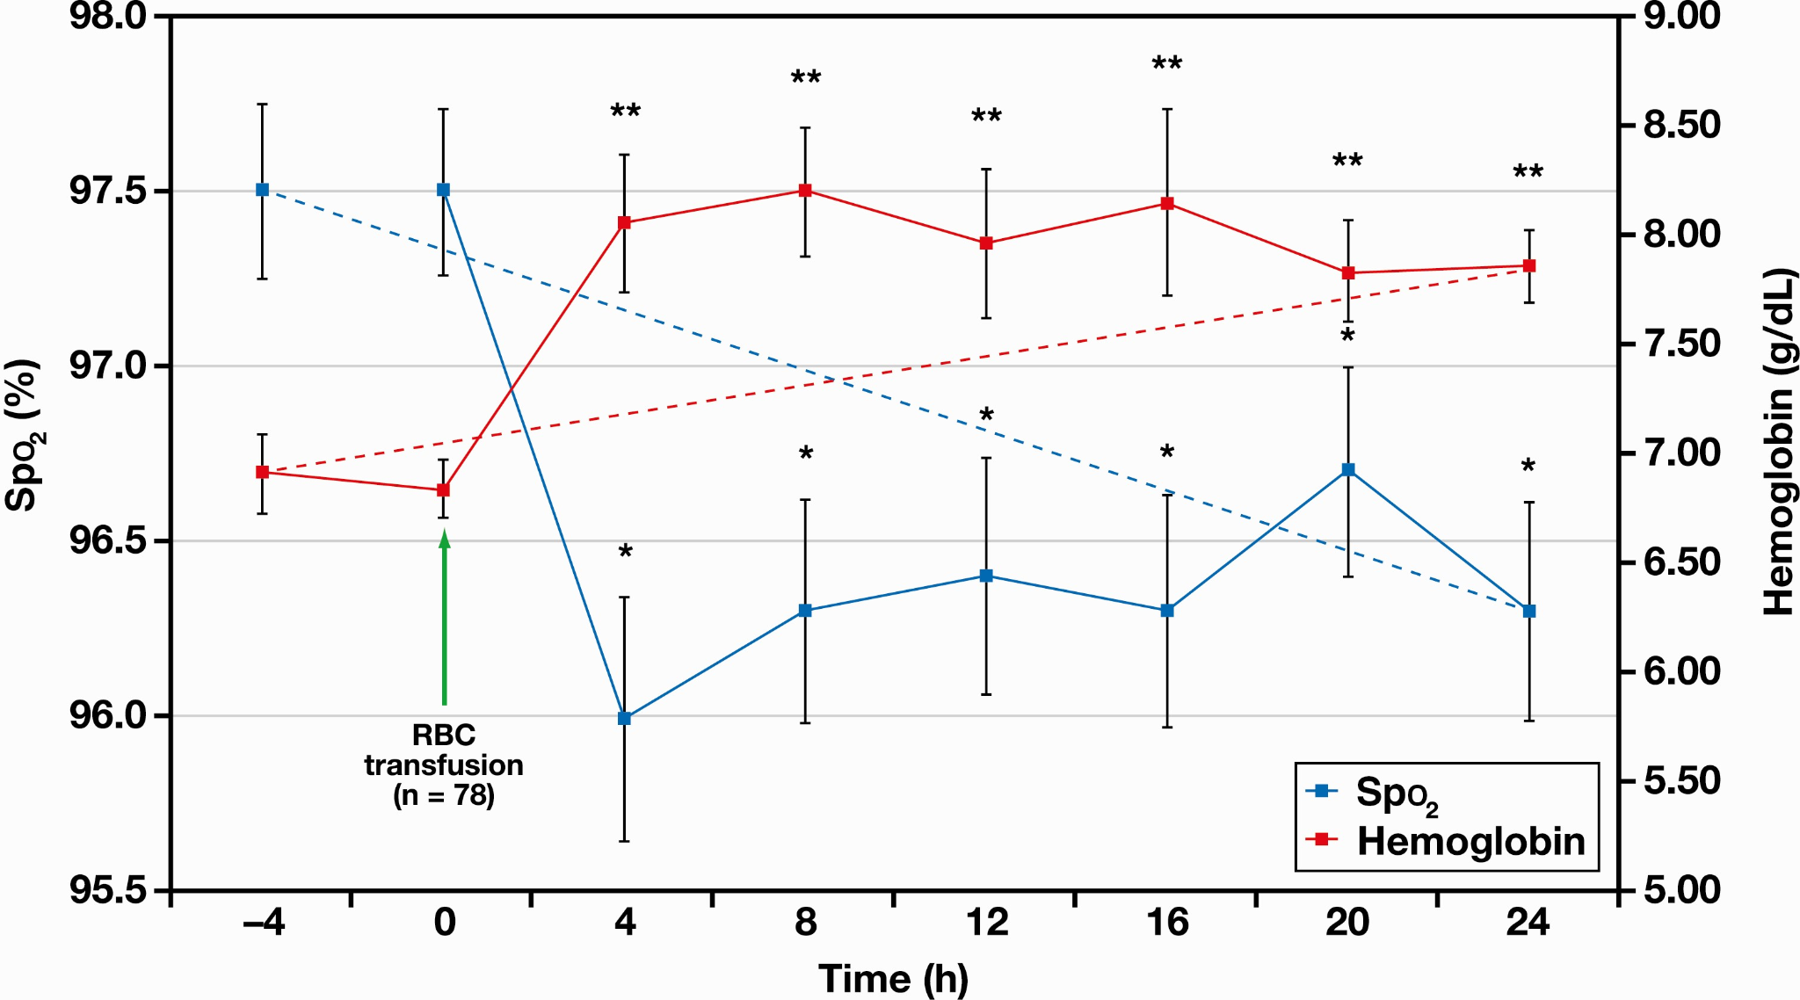
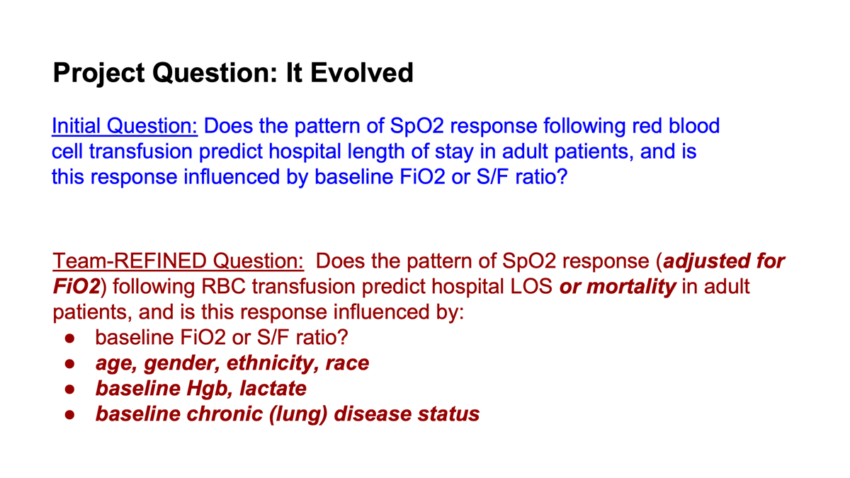
Background: RBC transfusion and SpO2 (blood O2) levels
meaningful outcomes: NONE captured (!)
Turgeman A. et al Am. J. Clin. Path. 2021
Notes:
There is limited data on how well RBCs do their jobs - absorbing O2 in the lung and delivering it to the body - but limited series like this one illustrate one reason why RBC transfusions may bring little benefit in ICU patients,

Slide 5
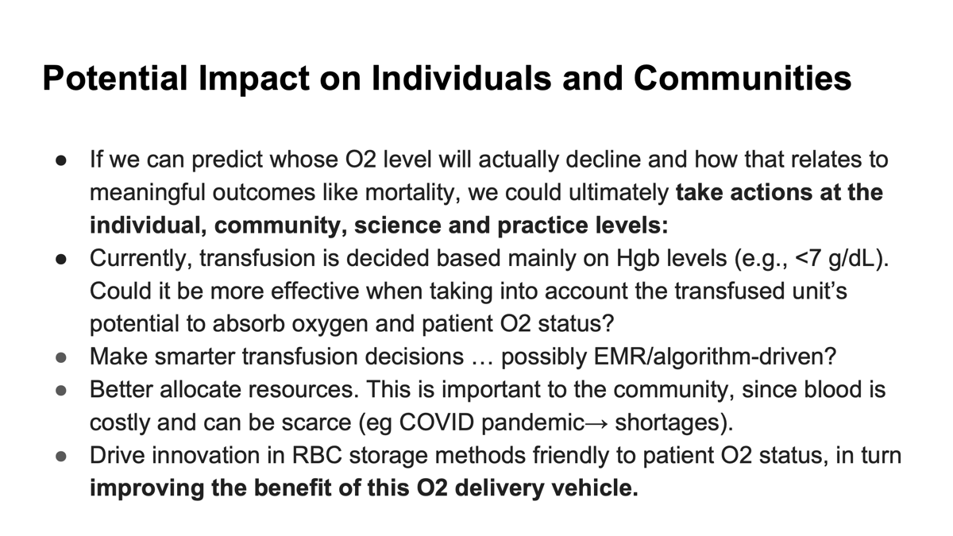
Project Question: How It Evolved
Initial Question: Does the pattern of SpO2 response following red blood cell transfusion predict hospital length of stay in adult patients, and is this response influenced by baseline FiO2 or S/F ratio?
Team-REFINED Question: Does the pattern of SpO2 response (adjusted for FiO2) following RBC transfusion predict hospital mortality or LOS in adult patients?

Slide 6
Background: RBC transfusion and SpO2 (blood O2) levels
meaningful outcomes: NONE captured (!)
Turgeman A. et al Am. J. Clin. Path. 2021
Notes:
There is limited data on how well RBCs do their jobs - absorbing O2 in the lung and delivering it to the body - but limited series like this one illustrate one reason why RBC transfusions may bring little benefit in ICU patients,

Slide 7
Data Sources
PhysioNet: eICU(I) Collaborative Research Database
Multi-center database comprising deidentified health data associated with over 200,000 admissions to ICUs across the United States between 2014-2015.

Slide 8
Key Variables: Dictionary
Outcomes: ICU mortality, LOS
Predictors: change in SpO2 pattern
Covariates:
age, gender, ethnicity
Hgb (blood count), lactate (O2 deficiency)
APACHE score, Charlson score
baseline FiO2, base S/F ratio
sepsis, chronic lung disease
vasopressor

Slide 9
Workflow:
Connect to BigQuery via Colab and extract RBC transfusion data
Keep first transfusion for multiple-transfusion patients
Exclude patients based on certain criteria
Add data on covariates
Clean O2 flow data and add to datasets
Finalize dataset and build the models
SpO2ial foRCes
Notes:
No O2 device, no ventilator -> considered as

Slide 10
Extracted 20,100 patient records from “intake & output → RBC transfusion”
For patients that received multiple transfusion, kept only the 1st transfusion event as long as it was more than 12 hours away from the 2nd transfusion
Excluded patients that received dialysis
Excluded patients that received RBC transfusion before ICU admission
Excluded patients for whom not SpO2 and FiO2 data was not available
Excluded patients with a null hospital discharge status
2900 patients

Slide 11
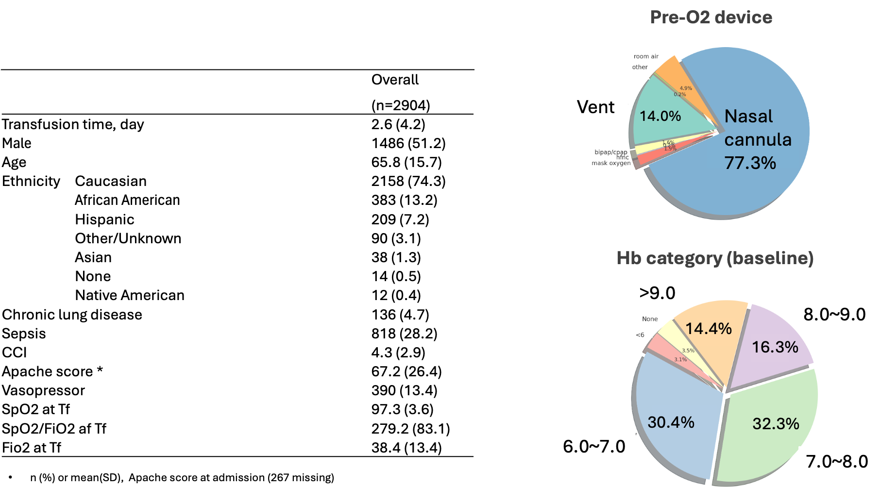
Baseline characteristics

Slide 12
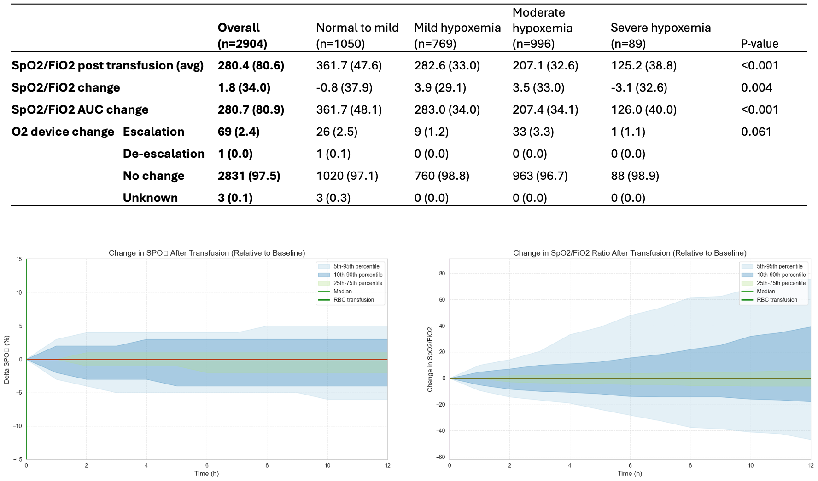
SpO2/FiO2 change post-transfusion
ΔSpO2
ΔSpO2/FiO2

Slide 13
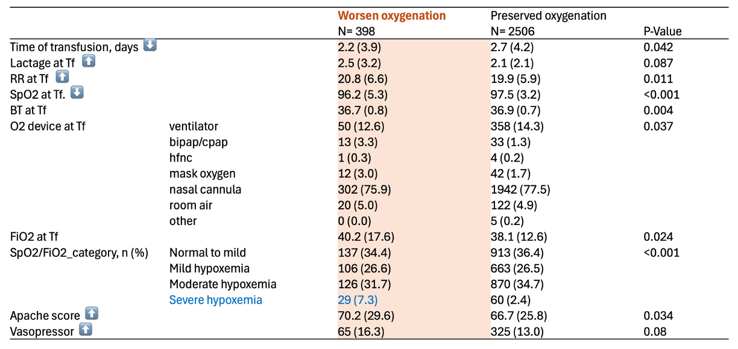
Who had oxygenation worsen after transfusion?
(escalation of O2 device or >5% decrease of SpO2/FiO2 in 12hr)

Slide 14
Analysis Approach
Primary Outcomes:
Mortality (Alive vs. Dead)
Length of Stay (minutes, positive integer count)
TRADITIONAL
VS
Xgboost
Logistic Regression for Mortality
Negative Binomial Regression for LOS

Slide 15
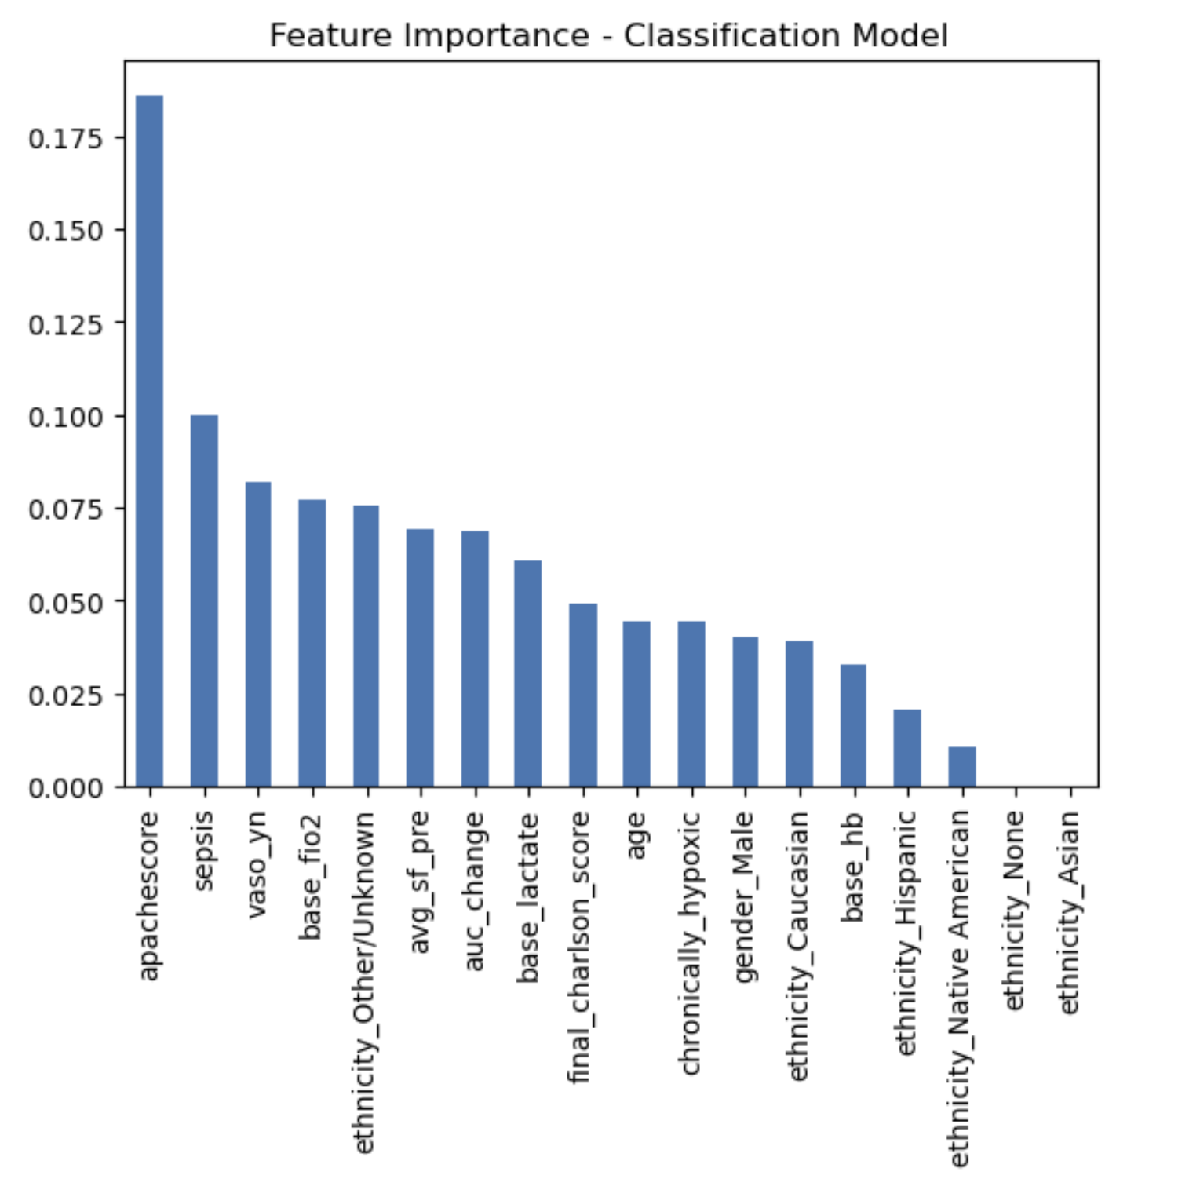
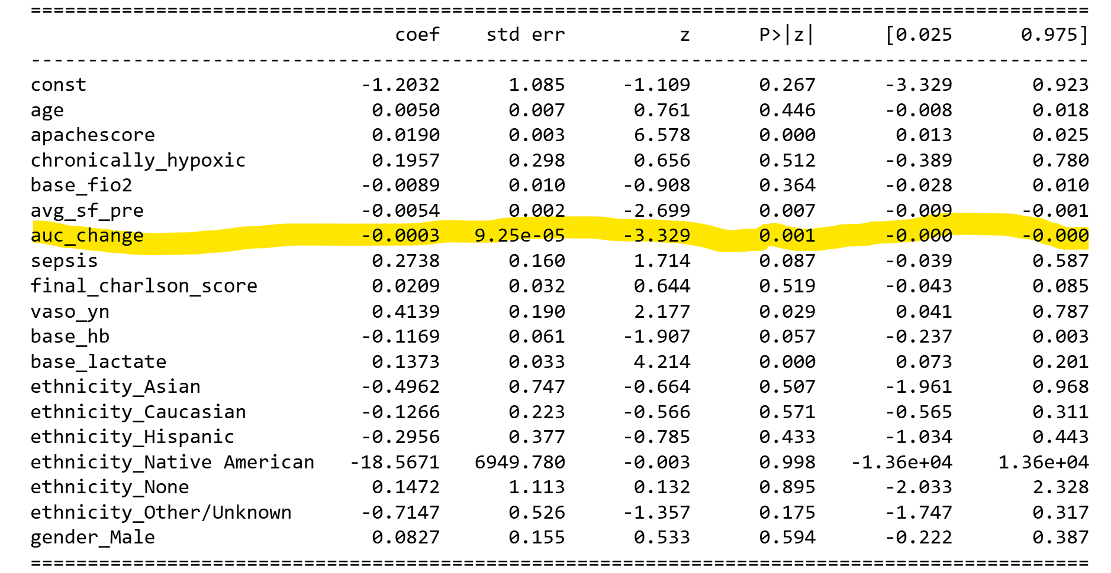
XGBoost (ML) Result: In-hospital mortality
log [LOS] to account for skewness
Change in S/F ratio after RBC transfusion is a statistically significant and important predictor for in-hospital mortality
Accuracy: 84%
“Higher auc_change is associated with a lower chance of in-hospital death (Expired)”
Notes:
Mean SHAP value for auc_change: -0.010535)

Slide 16
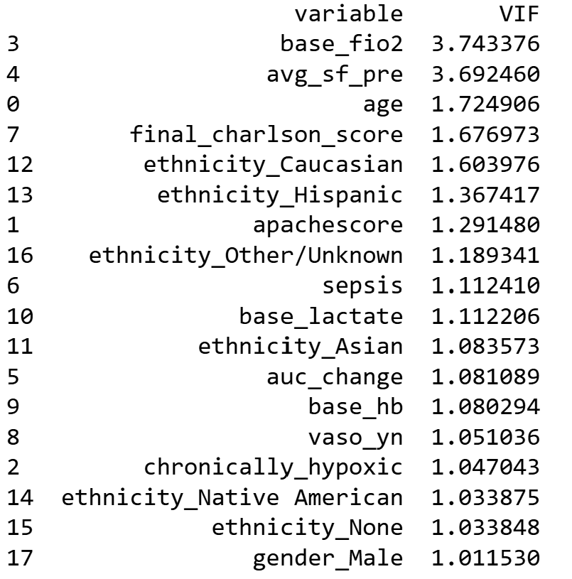
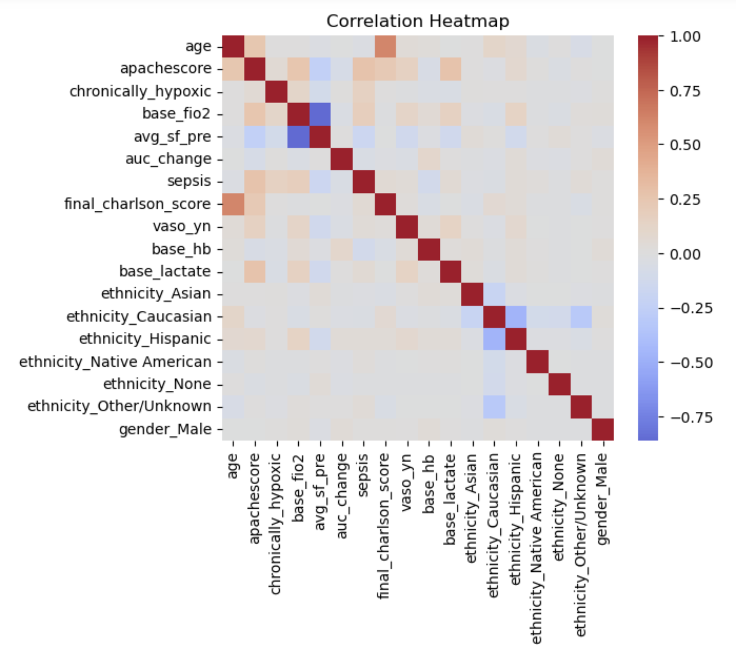
Addressing multicollinearity - XG Boost

Slide 17
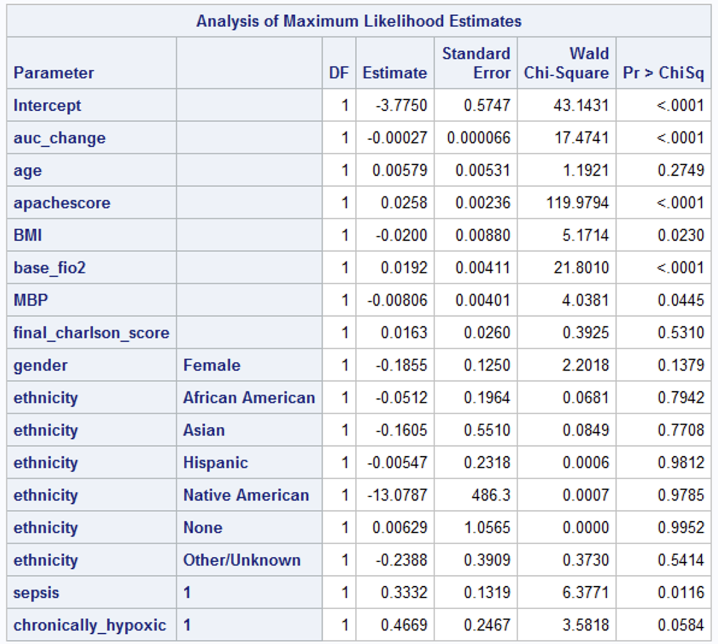
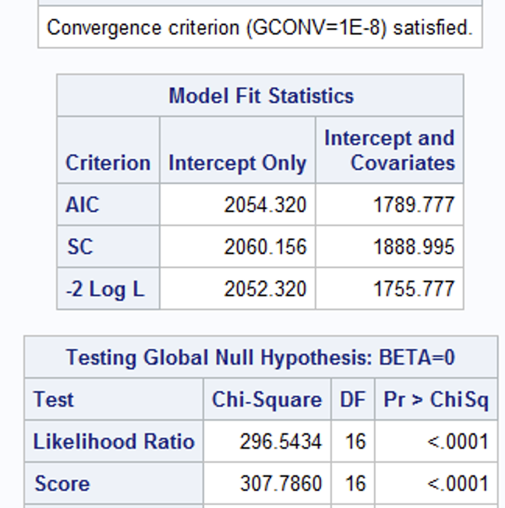
Logistic Regression
TRADITIONAL
Mortality Prediction

Slide 18
Logistic Regression: Mortality Prediction
TRADITIONAL
Higher SpO₂ improvement ⇒ lower mortality risk
APACHE score, FiO₂, and sepsis ⇒ increased mortality risk

Slide 19
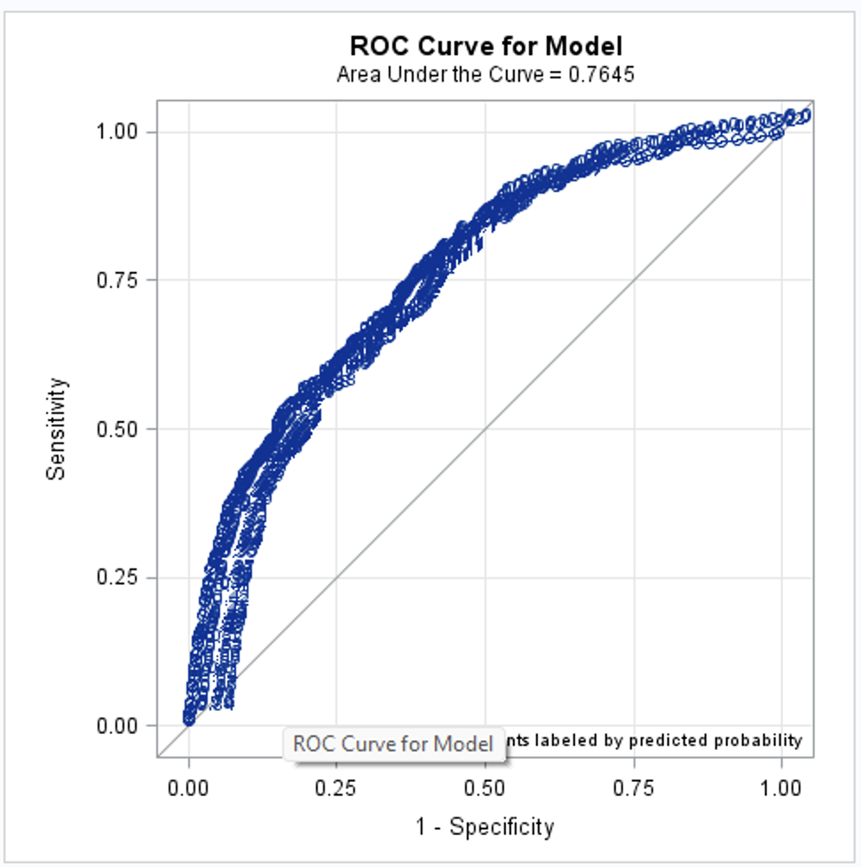
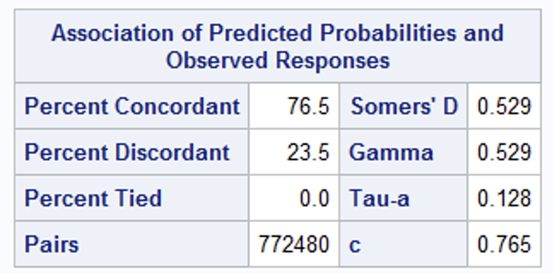
Logistic Regression
TRADITIONAL
ROC curve : AUC of 0.765,
-> model has moderate discriminative power.

Slide 20
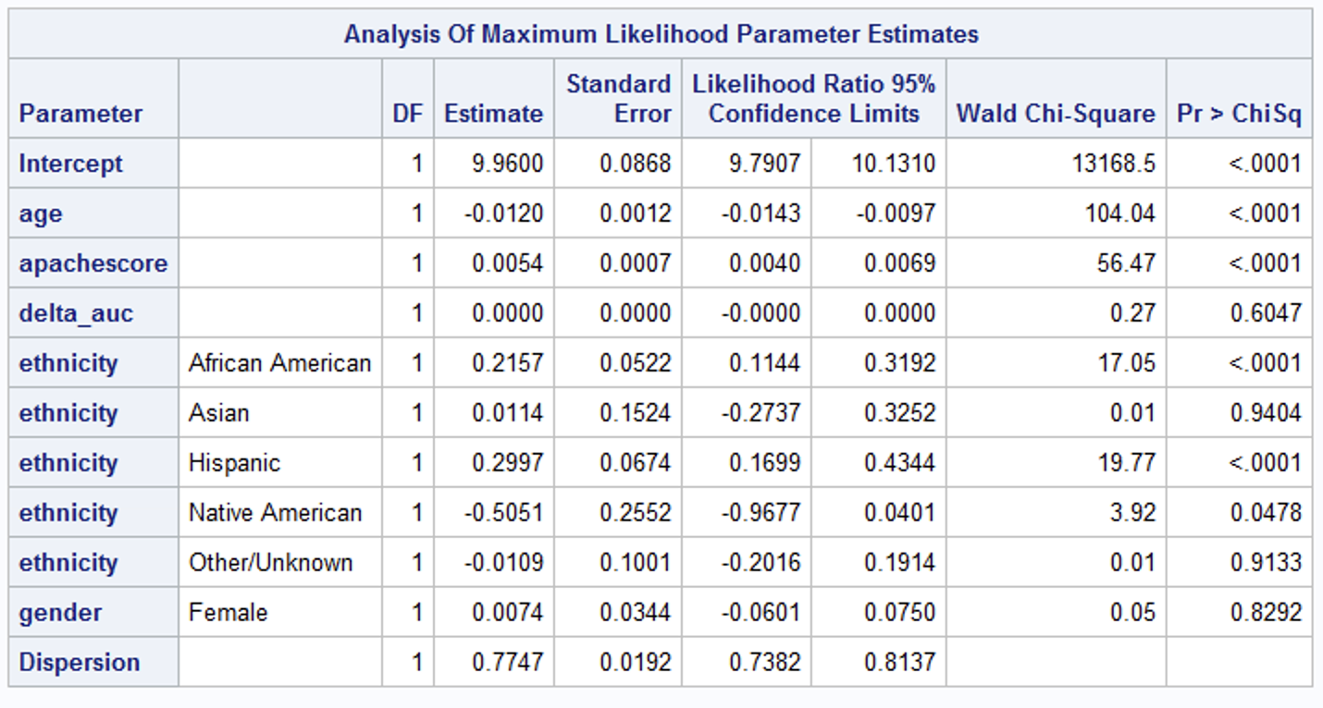
Negative Binominal Regression
TRADITIONAL

Slide 21
OVERDISPERSION
Overdispersion occurs when a dataset’s variance greatly exceeds the mean, violating the Poisson assumption of equal mean and variance.
Traditional machine learning models (e.g., random forests) do not explicitly account for this issue because they lack a distribution-based framework, potentially leading to misleading interpretations.
Hence, employing a Negative Binomial or similar model that incorporates extra dispersion is essential to properly handle overdispersion.

Slide 22
Limitations of our analysis
missing data: uncertain effect, but this might skew cohort “sicker” (testable)
O2 device and other data are “noisy” (>80 terms for 5 O2 support ‘situations’!)
single database
data are from 2014-5, but restrictive (‘less is more”) RBC transfusion practice (as now) was already widely used then (visibly ~so in this eICU cohort).
Notes:
Anecdotally i will never forget the long string of data where SpO2 values (95,98,96) were mistakenly placed in the FiO2 column!! Tim
Our model is not perfect and we have addressed the limitations in a later slide. We do see practical application for our hypothesis and have outlined steps to improve it in the future.

Slide 23
Next Steps for SpO2ial foRCes (Team 4)
Cluster analysis
Query eICU-II, MIMIC, K-MIMIC (racially homogeneous)
Query matched blood gas data, both to test for agreement re OUTCOME link, and to assess for racial or other bias in this dynamic sequence
Does RBC transfusion adversely impact other organ systems (kidney, brain)?
Consider conditions/markers reflecting anemia causes (chronic v. ICU induced (phlebot.) v. new chemotherapy, GI bleeding, trauma…) as covariates

Slide 24
Thank you!!
Mentors and Speakers
Dr. Ian Wong and the other organizers
teammates on SpO2ial foRCes (Team 4)
Notes:
Anecdotally i will never forget the long string of data where SpO2 values (95,98,96) were mistakenly placed in the FiO2 column!! Tim

